Slide 1

Detroit’s Pro Sports Teams
Assignment 4
Cody Adams
CSC121
10/13/2005

Slide 2



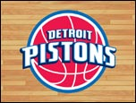
The ‘D’, The Motor City, Hockey Town – Detroit has many nicknames, all of which are used to talk about the place where the Tigers, Pistons, Red Wings, and Lions play their respective sports

Slide 3
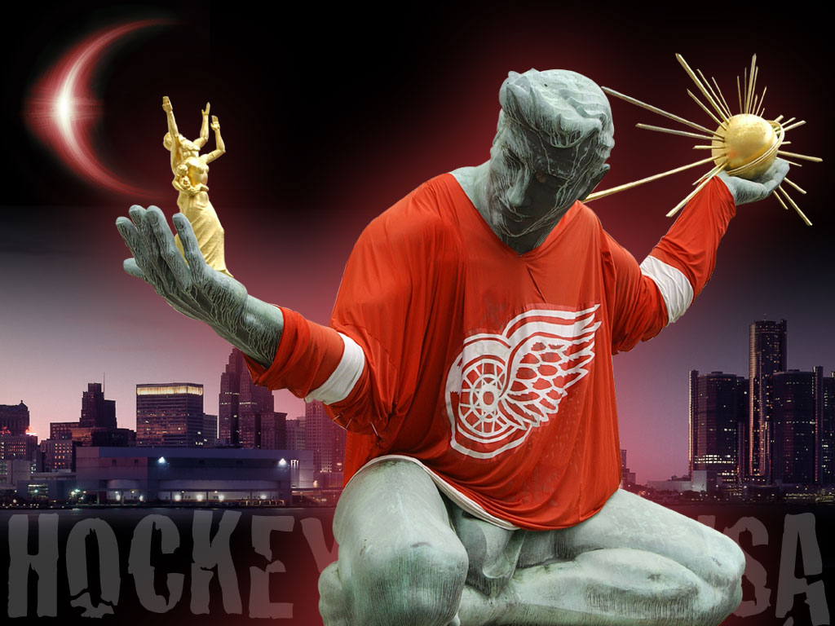

The Detroit Red Wings
I’ll start with the most successful Detroit franchise, the Red Wings. The Wings play hockey and are the most successful team in NHL history, most recently with two championships in three seasons.

Slide 4
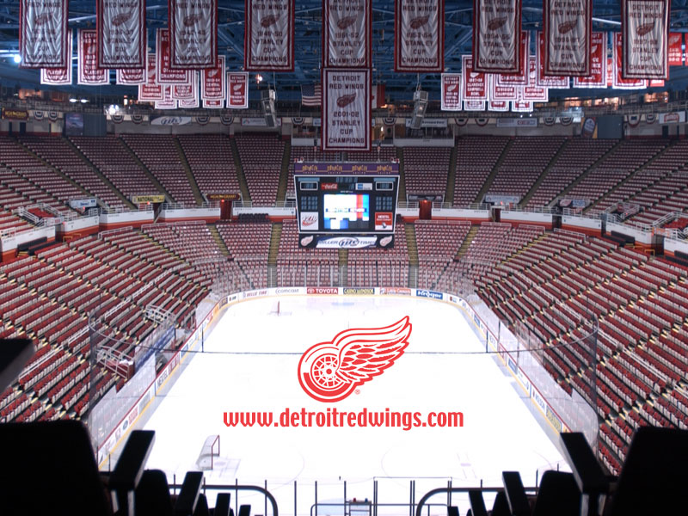


A history of Winning
The Red Wings are Detroit’s crown jewel of sports with ten championships in their history.

Slide 5
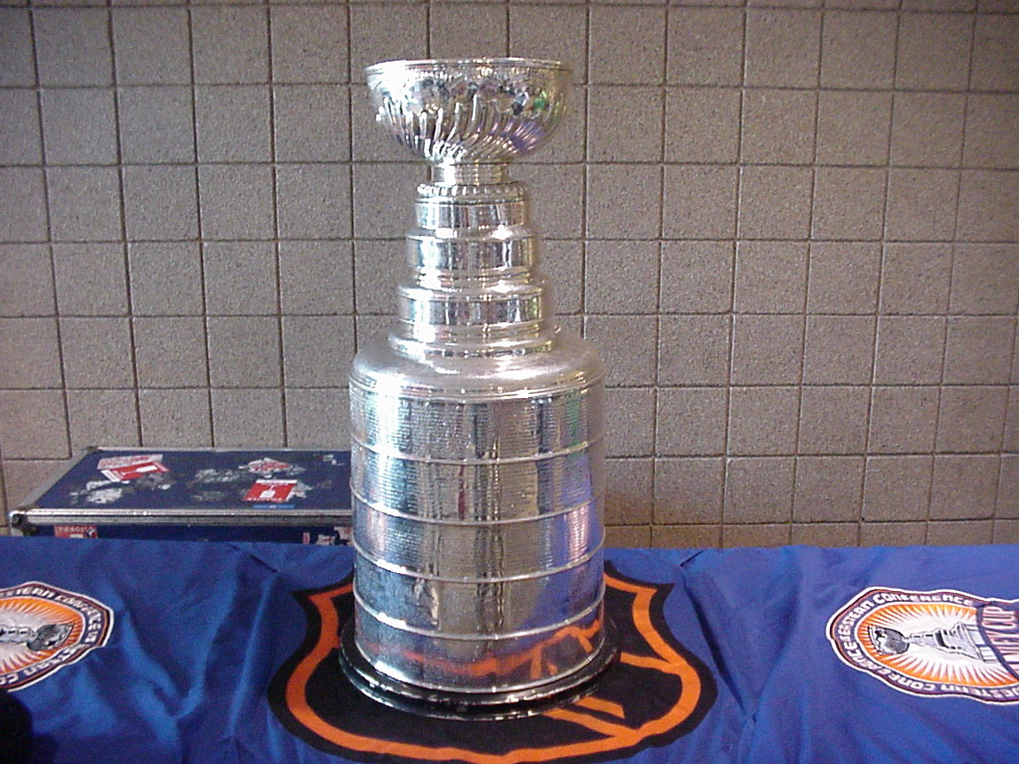
The Stanley Cup
One of sports’ greatest trophies, The Stanley Cup has a rich history, which includes ten stops in Detroit. After winning the NHL championship, tradition holds that each member of the team takes The Stanley Cup home for a day. The rings you see list each of the names of all the players of each championship throughout history.

Slide 6
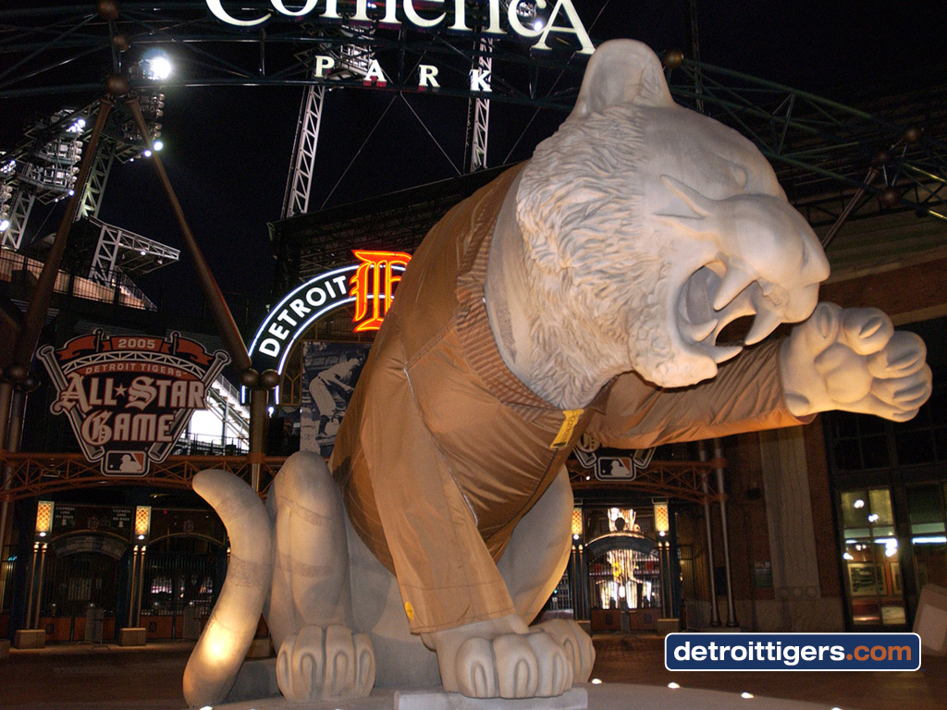
The Detroit Tigers
It sure is cold in Detroit in Winter!
Next up are my favorite, the baseball team, The Tigers. Although they have not been competitive in several years, going to a baseball game is still one of the best things you can do in the summertime.

Slide 7
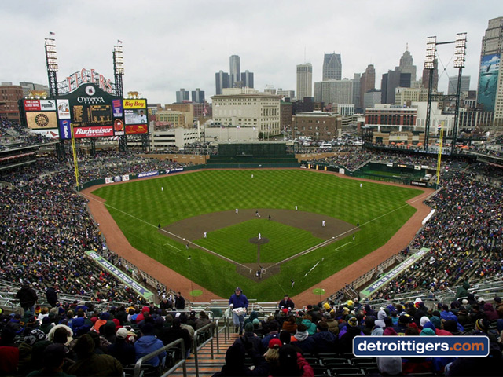
This is Comerica Park, the home of the Detroit Tigers since 2001, when they retired old Tiger Stadium. As you can see, it is a beautiful stadium with a great view of the city skyline.

Slide 8
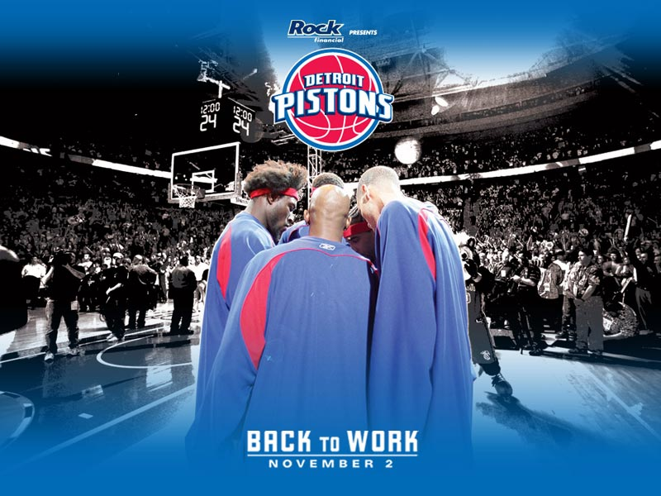
The Detroit Pistons
The most recent franchise to bring a championship to Detroit is the Pistons. They were champs of the NBA in 2003-04 and return to the NBA Finals in 2004-05

Slide 9
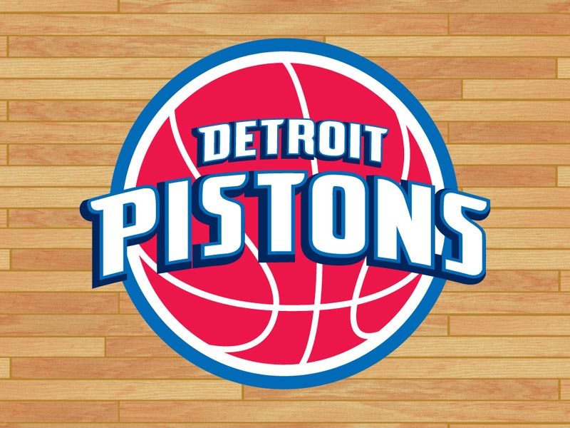
Goin’ To Work
The Pistons are a hard working team for a hard working city. They play and win with gritty, hard play and do everything they can to get a city searching for an identity to identify with them

